Slide 1
Predicting Obesity Status
Qiyang Chen, Xinyao Chen, Riya Hariyaplar, Yutian Yang, Zijia Zhang

Slide 2
Table of contents
01
02
03
04
Introduction
Methodology
Background information for obesity status in U.S.
Data cleaning and models
Results
Final model:
random forest
Discussion
Limitations & Recommendations

Slide 3
01
Introduction
Background information for obesity status in U.S.

Slide 4
Obesity in the U.S.
A Public Health Challenge
Over 40% of adults and nearly 20% of children affected
Complex interactions of
Environmental
Occupational
Socioeconomic factors
Severe health conditions
Cardiovascular disease
Diabetes
Mental health challenges
Notes:
Over 40% of adults and nearly 20% of children face obesity problem, which can lead to severe health conditions, including cardiovascular disease, diabetes, and mental health challenges, influenced by complex interactions of environmental, occupational, and socioeconomic factors.

Slide 5
02
Methodology

Slide 6
Obesity Dataset
32014 observations
29 predictors
Training Dataset
11 numerical predictors
age, height, cholesterol level, technology use
18 categorical predictors
transportation methods, marriage status, race
Notes:
Numerical Variables (11 total):
Health metrics: Age, Height, Resting Blood Pressure, Cholesterol Level, Maximum Heart Rate, Average Glucose Level
Lifestyle factors: Frequency of vegetable consumption, Number of main meals, Daily water intake, Physical activity frequency, Technology use time
Categorical Variables (18 total):
Demographics: Gender (Female/Male), Race (Asian/Black/Hispanic/White), Marital status (Yes/No), Residence type (Rural/Urban)
Health conditions: Heart Disease (Yes/No), Hypertension (Yes/No), Stroke (Yes/No)
Lifestyle factors: High-calorie food consumption (Yes/No), Between-meal eating (No/Sometimes/Frequently/Always), Smoking status (Yes/No), Sweet drink consumption (Yes/No), Caloric intake (No/Sometimes/Frequently/Always), Transportation mode (Automobile/Bike/Motorbike/Public Transportation/Walking)
Medical indicators: Fasting Blood Sugar (Yes/No), Resting ECG (LVH/Normal/ST), Exercise status (Yes/No)
Other: Family history of overweight (Yes/No), Work type (Children/Government job/Never worked/Private/Self-employed)

Slide 7
The process
Clean data: Missing values imputation using mice() in R
Feature selection: Using VIF to check multicollinearity
Fit models
Analyze models: Compute testing accuracy
Compare models: Choose random forest as our final model
Notes:
8% of dataset contain NAs → need to deal with that
mice() → successfully impute all of them

Slide 8
Data Cleaning: Dealing with NAs
Constant rate of missing values:
8% for all the predictors in both training and testing dataset
Method 1:
Complete case analysis using na.omit() reduce the training dataset to 2,933 observations and the testing dataset to 986 observations.
Not great!
Method 2:
We applied mice() once, which successfully imputed all missing values in both training and testing datasets.
Notes:
Zijia

Slide 9
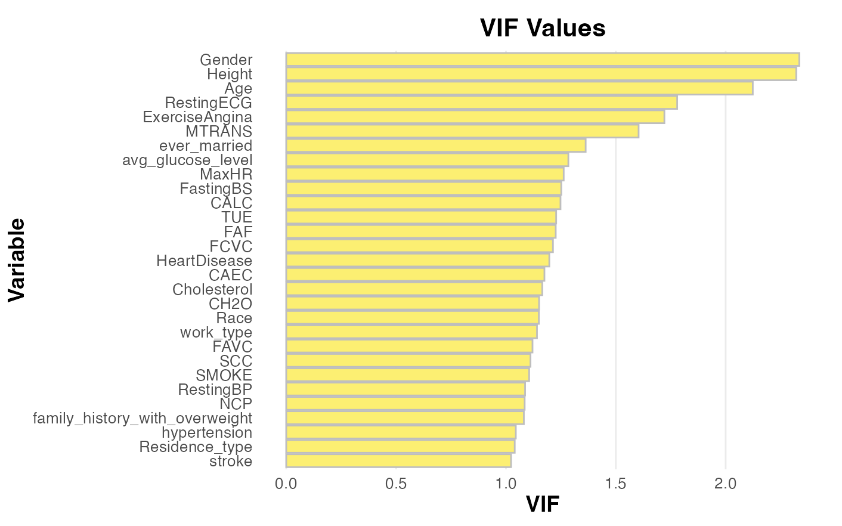
Feature Selection: Checking multicollinearity
Notes:
On the first look, there is no significant multicollinearity issues. Current setup is ready for use. Feature Selection and dimension reduction can be done later in the modelling.

Slide 10
Different models
（seed=500)
Linear models:
Logistic regression: full model + step() for feature selection
Regularization: Ridge/Lasso+CV
Dimension reduction: LDA+CV (QDA+CV)
Probabilistic method
Naive Bayes
KNN+CV
Other Non-linear models:
Bagging and trees
Random Forest
Notes:
Here is all the models we tried

Slide 11
03
Results

Slide 12
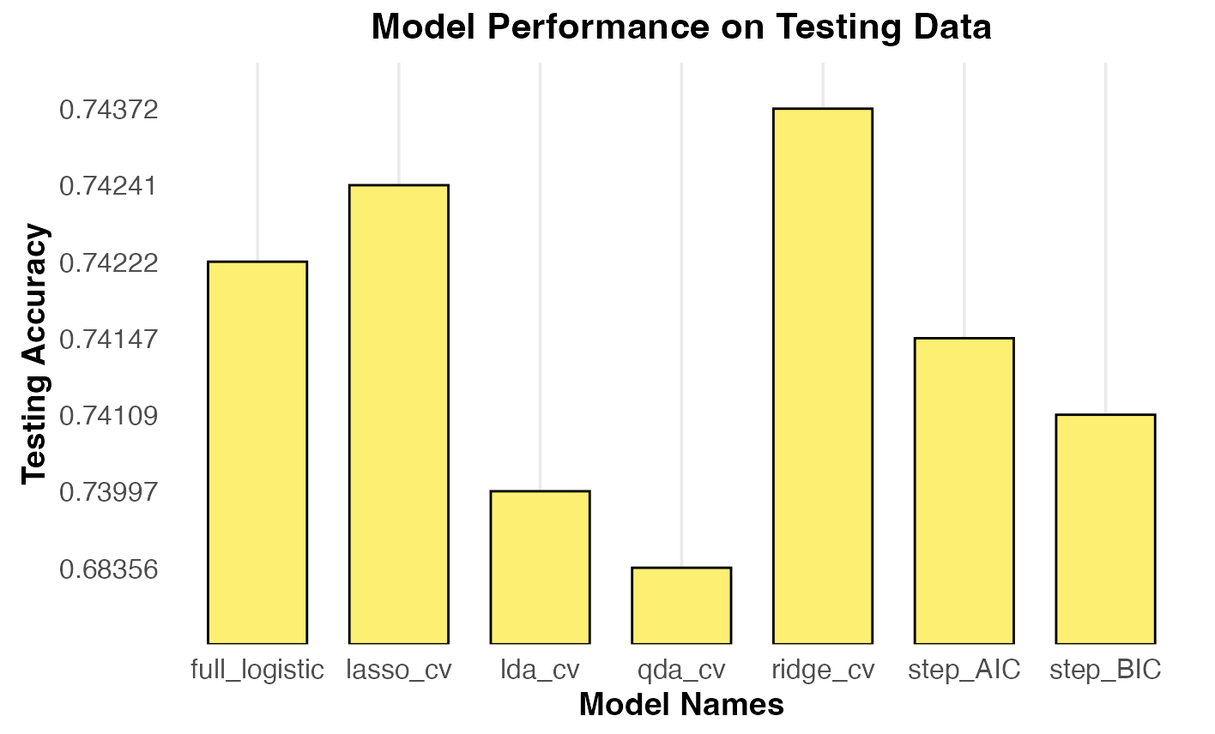
Accuracy: Linear Models
Notes:
Starting with a basic full logistic model with all the predictors, we improve our models by using stepwise functions(with direction = both) with AIC/BIC as criteria. Furthermore, we apply regularization such as ridge and lasso and apply cross-validation to choose the best penalty terms lambda. Besides, we also consider dimension reduction methods such as lda and qda(though not a linear model). The accuracy of each model on the testing dataset is shown in the graph. The regularization method performs the best among all the linear models. However, all of the accuracies fall in the range of 0.68-0.75, showing no significant differences. Therefore, we consider other non-linear models to further improve our accuracy.

Slide 13
Accuracy: Other models:
 | Models | Testing Accuracy | Limitation & Discussion
Probabilistic models | Naive Bayes | 0.6631 | assumption of feature independence might not hold
 | KNN | 0.6631 | curse of dimensionality
Non-linear Models | Trees | 0.79 | instability
 | Bagging | 0.97 vs 0.88 | may be high in variance
Notes:
Naive Bayes model and KNN model yield almost identical testing accuracy. The Naive Bayes (NB) and k-Nearest Neighbors (KNN) models achieved identical and relatively low accuracy scores of 0.66313, which could indicate limitations in their ability to capture the complexity of the data. For NB, this might stem from its strong assumption of feature independence, which may not hold true in this dataset. Similarly, KNN's performance might be hindered by the curse of dimensionality or insufficiently distinct feature separability in the data. Since the accuracy didn’t even beat the linear models, we won’t go further on these two models.
Trees→ highest so far, but still not ideal
Bagging → much improved
The prediction of a single decision tree is not ideal, but the error rate is much improved after bagging.

Slide 14
Final Model: Random forest
In previous trials we found out error for bagging is much lower than other models (~0.03 to ~0.3) and a single decision tree has rather high error
Lead us to make use of random forest model → Reduce variance
Train accuracy: 98.5%
 | Reference
Prediction | Not Obese | Obese
Not Obese | 19475 | 434
Obese | 56 | 12049
Confusion Matrix
Notes:
The training run yields an accuracy around 0.985
False negative seems more than false negative.
Even though random forest is very powerful in terms of model training, it is fairly easy to code and does not take too much time to run.
The benefit of using random forest is that it creates many trees that evaluate current model from different perspective and combine the output of each tree, which is very effective to reduce overfitting.
Reduce variance

Slide 15
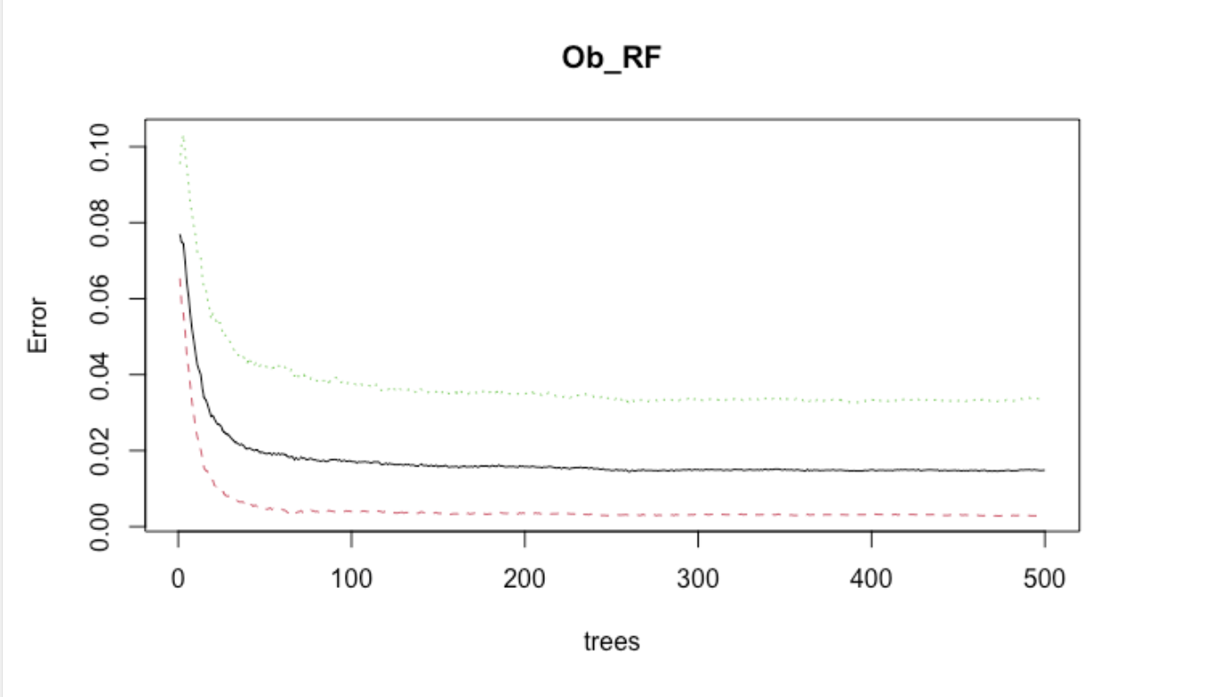
Hyperparameter tuning: ntree = 15
Visualization of error vs number of trees with training
Significant drop on around 15
Slight increase of acc ~2% from 15 to 250
No significant change afterwards
Decide upon ntree = 250
Final kaggle score: 0.982

Slide 16
04
Limitations & Recommendation

Slide 17
Limitations
RF method lacks transparency, like a “black box”
Hyperparameter tuning cap @ 250
Sample size, number of predictors, ran on 1 test set → difficult to generalize
Notes:
Reduce number of predictors

Slide 18
Recommendation
Extend project to give medical intervention
Include more key variables
Ethical considerations

Slide 19
Thanks!

